Slide 1

Build A Better Future:
Go Teach!
Teacher Pathways @ CSULB

Slide 2
Teacher Preparation Advising Center (TPAC)
Liberal Studies Advisors | Credential Program Advisors
Aleah Garnica | Jessica Olague
Gabriel Rodriguez | Elodia Montano
Nancy De Haro | Sheina Vogt
Office Coordinator: Amber Thomas
Office: EED-67
Phone: 562-985-1105
Email: ced-tpac@csulb.edu
Monday-Friday 9am-5pm
(Fridays/Winter or Summer Break closed from 12-1pm)

Slide 3




The Pathways of Teaching
Notes:
Questions to ask
Who wants to become an elementary school teacher?
Who wants to become a middle school or high school teacher?
Complete BA, if possible in the area of study. Complete CSET.

Slide 4
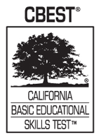
California Basic Educational Skills Test
CBEST
What is it:
It is a way to meet the CA Basic Skills Requirement (one of 8 ways)
3 sections: Reading (MC), Mathematics (MC) and writing section with 2 essays.
Can take each section separately or take them together.
Who takes it:
Applying to a teaching credential program
Seeking employment in CA, in a school distract
Applying for the issuance or renewal of an Emergency Permit

Slide 5
California Subject Examinations for Teachers (CSET)
What is it?
A timed exam divided into 3-5 different sections
Each section has a specific content focus.
Why Take the CSET?
California teaching credential candidates are required by law to verify their subject matter knowledge and competencies.

Slide 6
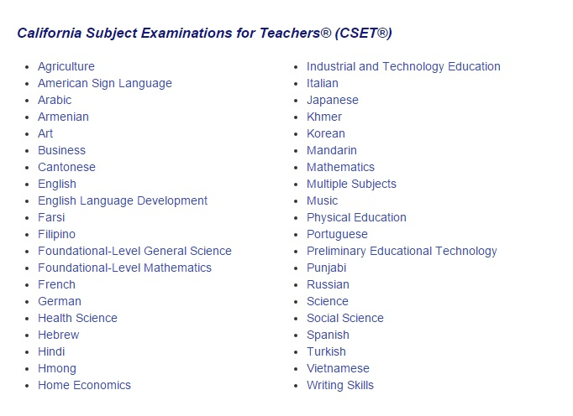
CSET Content Areas

Slide 7

Elementary School Teacher
Two Routes
Undergraduate | Post- Baccalaureate
Pursue BA in Liberal Studies & chose the ITEP pathway | Graduate with a BA in Liberal Studies or any BA and apply to the Multiple Subject Credential Program (MSCP)

Slide 8

What is Liberal Studies?
Unique Features & Things to Know!
What is it?
  Prepares students for careers in the field of education.
    Primary Focus: Elementary Education
    Secondary Focus: Special Education (if desired)
  Liberal Studies is an option for future educators.
  Program follows California Common Core Standards & Teacher Credentialing (May be subject to change).
  Includes Credential Pre-Requisites & Co-Requisites (with ITEP)
General Education
  Liberal Studies does not follow the traditional GE pattern.
  Not all GE classes will satisfy the requirements.
Grading
  Letter Grades Only (A-F); No CR/NC options.
  All classes must have C or better.
“Unique Butterfly”
Type of Major

Slide 9
Liberal Studies
Undergrad & Credential Pathways
ITEP Program | What do you Earn? | Units/Years
Liberal Studies (ITEP) Multiple Subject | BA + Multiple Subject Credential | 135 Units 4 or 4.5 or 5 year Degree
Liberal Studies (ITEP) Urban Dual Credential Cohort Model | BA+ Multiple Subject Credential + Education Specialist Credential | 135 Units 5 Year Degree
Liberal Studies (ITEP) Dual Special Education Credential | BA+ Multiple Subject Credential + Education Specialist Credential | 135 Units 5 Year Degree
Liberal Studies (ITEP) Multiple Subject Credential with Spanish BILA | BA + Multiple Subject Credential + Spanish Authorization | 135 Units 4 or 4.5 or 5 year Degree

Slide 10

PATHWAY COMPARISON
BA Only 120 units | ITEP135 units
BA only 120 units total Service Learning (45 Hours) Concentration Requirement Credentialing Post-Bac Elementary Subject Matter Waiver Program | BA & Credential(s) 135 units total Service Learning (85 Hours) Methods Courses in Senior year ITEP UDCP & MSCP Pathways Elementary Subject Matter Waiver Program

Slide 11
Post-Baccalaureate
Teaching Credentials
Multiple Subject Credential Program (40 units)
  Elementary School Teacher
Special Education Credential Program (46 Units)
  Special Education Teacher
Urban Dual Credential Program (54 units)
  Elementary School Teacher
  Special Education Teacher
Notes:
Already obtained Bachelors Degree
Reapply to CSULB as a Post-Bac applicant for the Teaching Credential Program

Slide 12
Single Subject Credential
Program
For Becoming a Middle School or High School Teacher
Need to obtain your Bachelors of Arts or Science
Demonstrate Subject Matter Competency in the subject area you wish to teach
  Completing an approved subject matter preparation program
  Subject Matter Waiver Evaluation
  Passing the appropriate CSET Examination
Satisfy Basic Skills Requirement
  Through CBEST or other CTC Approved Examination
Apply to the Single Subject Credential Program

Slide 13

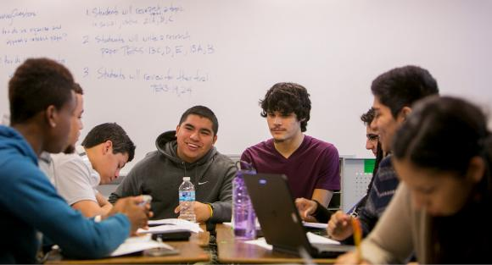
Single Subject Credential
Program
45 units total
  15 units pre-requisites/Co-requisites
  12 units core courses
  18 units student teaching
Can be completed in 3 semesters – with full time status
Program is self-paces and must be completed within 7 years

Slide 14
Subject Area Programs
Art Education
  BA in Arts Option in Art Education
English Education
  BA in English Option in English Education
Health Science Education
World Languages (LOTE)
Mathematics Education
  BS Option in Mathematics Education
Music Education
  BA Option Music Education
  Audition as music education majors
Physical Education
  Bachelor of Science in Kinesiology,
    Option K-12 Physical Education Teacher
    Option Adapted Physical Education
Science Education
  Obtain BA in any area of Science
Social Science Education

Slide 15
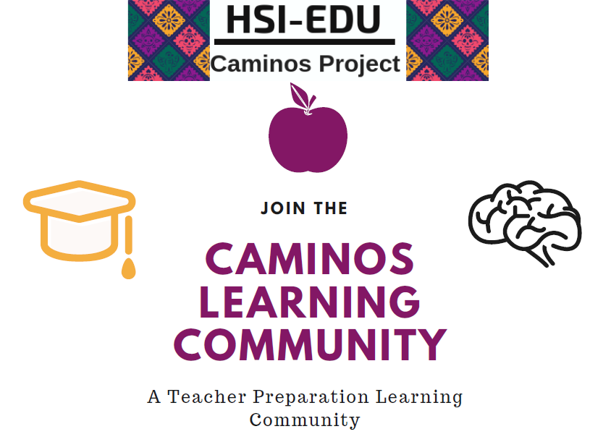
College of Education Resources
College of Education Scholarships
  Application cycle Nov 1st to Mar 2nd
  Prospective Student planning to start in the Fall can submit an application
    Need to Submit University Application by Feb 1st
    Min GPA of 3.0 or greater
Teacher Resource Center
  Free Printing (15 pages daily)
  Scanners, Die-cuts, Project Materials
  Test Prep Guides for CBEST, CSET & RICA
Caminos Learning Community
  Professional Development
  Teacher network opportunities
  Latinx Teacher Mentor Partnership
  Subject Matter Preparation

Slide 16
CED STUDENTS GET INVOLVED
SAMs
Student Ambassadors
COESA
College of Education Student Assembly
LSSA
Liberal Studies Student Association

Slide 17


Questions?
Connect with:
Outreach & Recruitment Office
Wendy Muzien
562-985-2036
ced-outreach@csulb.edu

