Slide 1

Unpacking STEM AGENCY for
STEM in-service, pre-service teachers, and STUDENTS
Developed by Christina Restrepo Nazar, Ph.D.
For Rio Hondo Community College
Notes:
In this slide, presenters will introduce themselves to the audience which should include preservice teachers, in-service teachers and K-12 students. The purpose of this presentation is to unpack identity (as in who one is) and agency (why one takes action) for each of these stakeholders in science, technology, engineering and mathematics. In order to do this, we will focus on our roles as each of these stakeholders and how and in what ways our roles interact with who we are, what we bring into science and then how we support other students, colleagues and stakeholders in STEM education.

Slide 2

Summarizing yesterday’s work
Youth come into STEM with their own unique repertoires of practice (Gutierrez & Rogoff, 2003)
Science is a phenomeno-centric discipline—meaning experiences with phenomenon and perspectives of those experiences drives our ideas for now and in the future (scientific literacy)
In addition to being culturally relevant or culturally sustaining in our teaching practices, we must look towards redefining systemic changes in teacher preparation rather than remedial efforts for students.
Notes:
In this slide, the presenter can begin by asking the question: How many of you feel comfortable with science?
They can then gauge a percentage of people who responded.
The next question is: Raise your hand if you are a teacher or preservice teacher. Then ask the question: Do you feel comfortable teaching science?
Then focus on the students: Raise your hand if you are a student? Do you feel comfortable with your science learning?
Some people may respond, others may not. However, more generally, based on the audience responses we can gauge that some teachers (especially elementary teachers) will not feel comfortable with teaching science. Oftentimes, students will feel that they don’t feel represented in their science education, or its not fun, or you can’t really do anything with it in context (real-life).
Then, with the slide, we will begin by beginning with who we are. Youth come into STEM with their own unique repertoires of practice. Repertoires of practice reminds us of how individual students bring in specific practices into their learning that are oftentimes overlooked because they are members of a group who has been recognized as not participating or not engaging in certain topics or areas. For example, something that would go against repertoires of practice would be the model minority myth that all Asian students excel in math or science. There may be students that are stereotyped and pressured to succeed due to essentializing their individual experiences as part of a membership in a group. Likewise, it can also be bringing in rap lessons into a classroom with majority African American students. You may make this assumption because the majority of rappers are African American and believe all students in this group may relate to listening to rap.

Slide 3
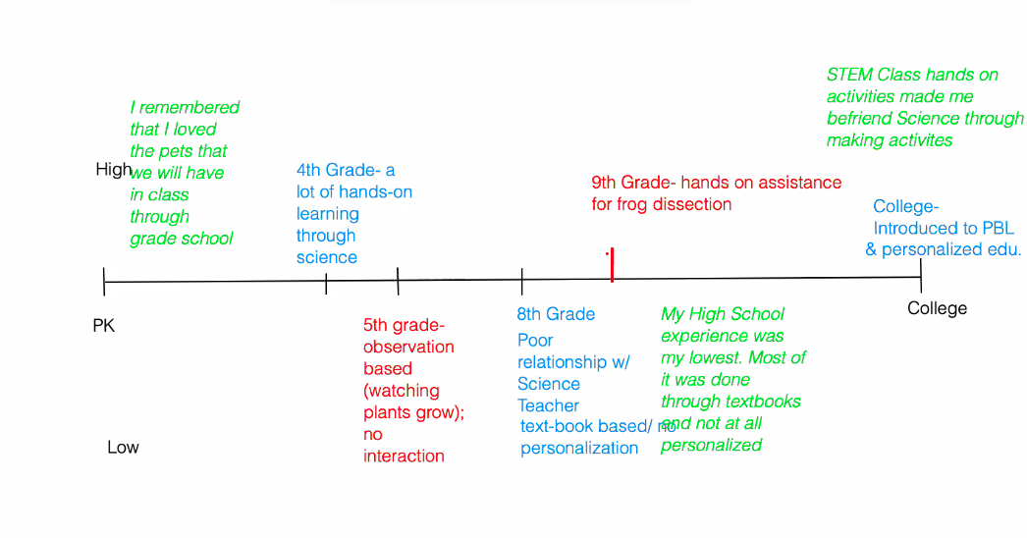
Identity and connections to K-16 schooling
High Moments
Low Moments
Middle school connection
High school disconnection/focus on discursive practice
College interest and attrition
Teacher education

Slide 4
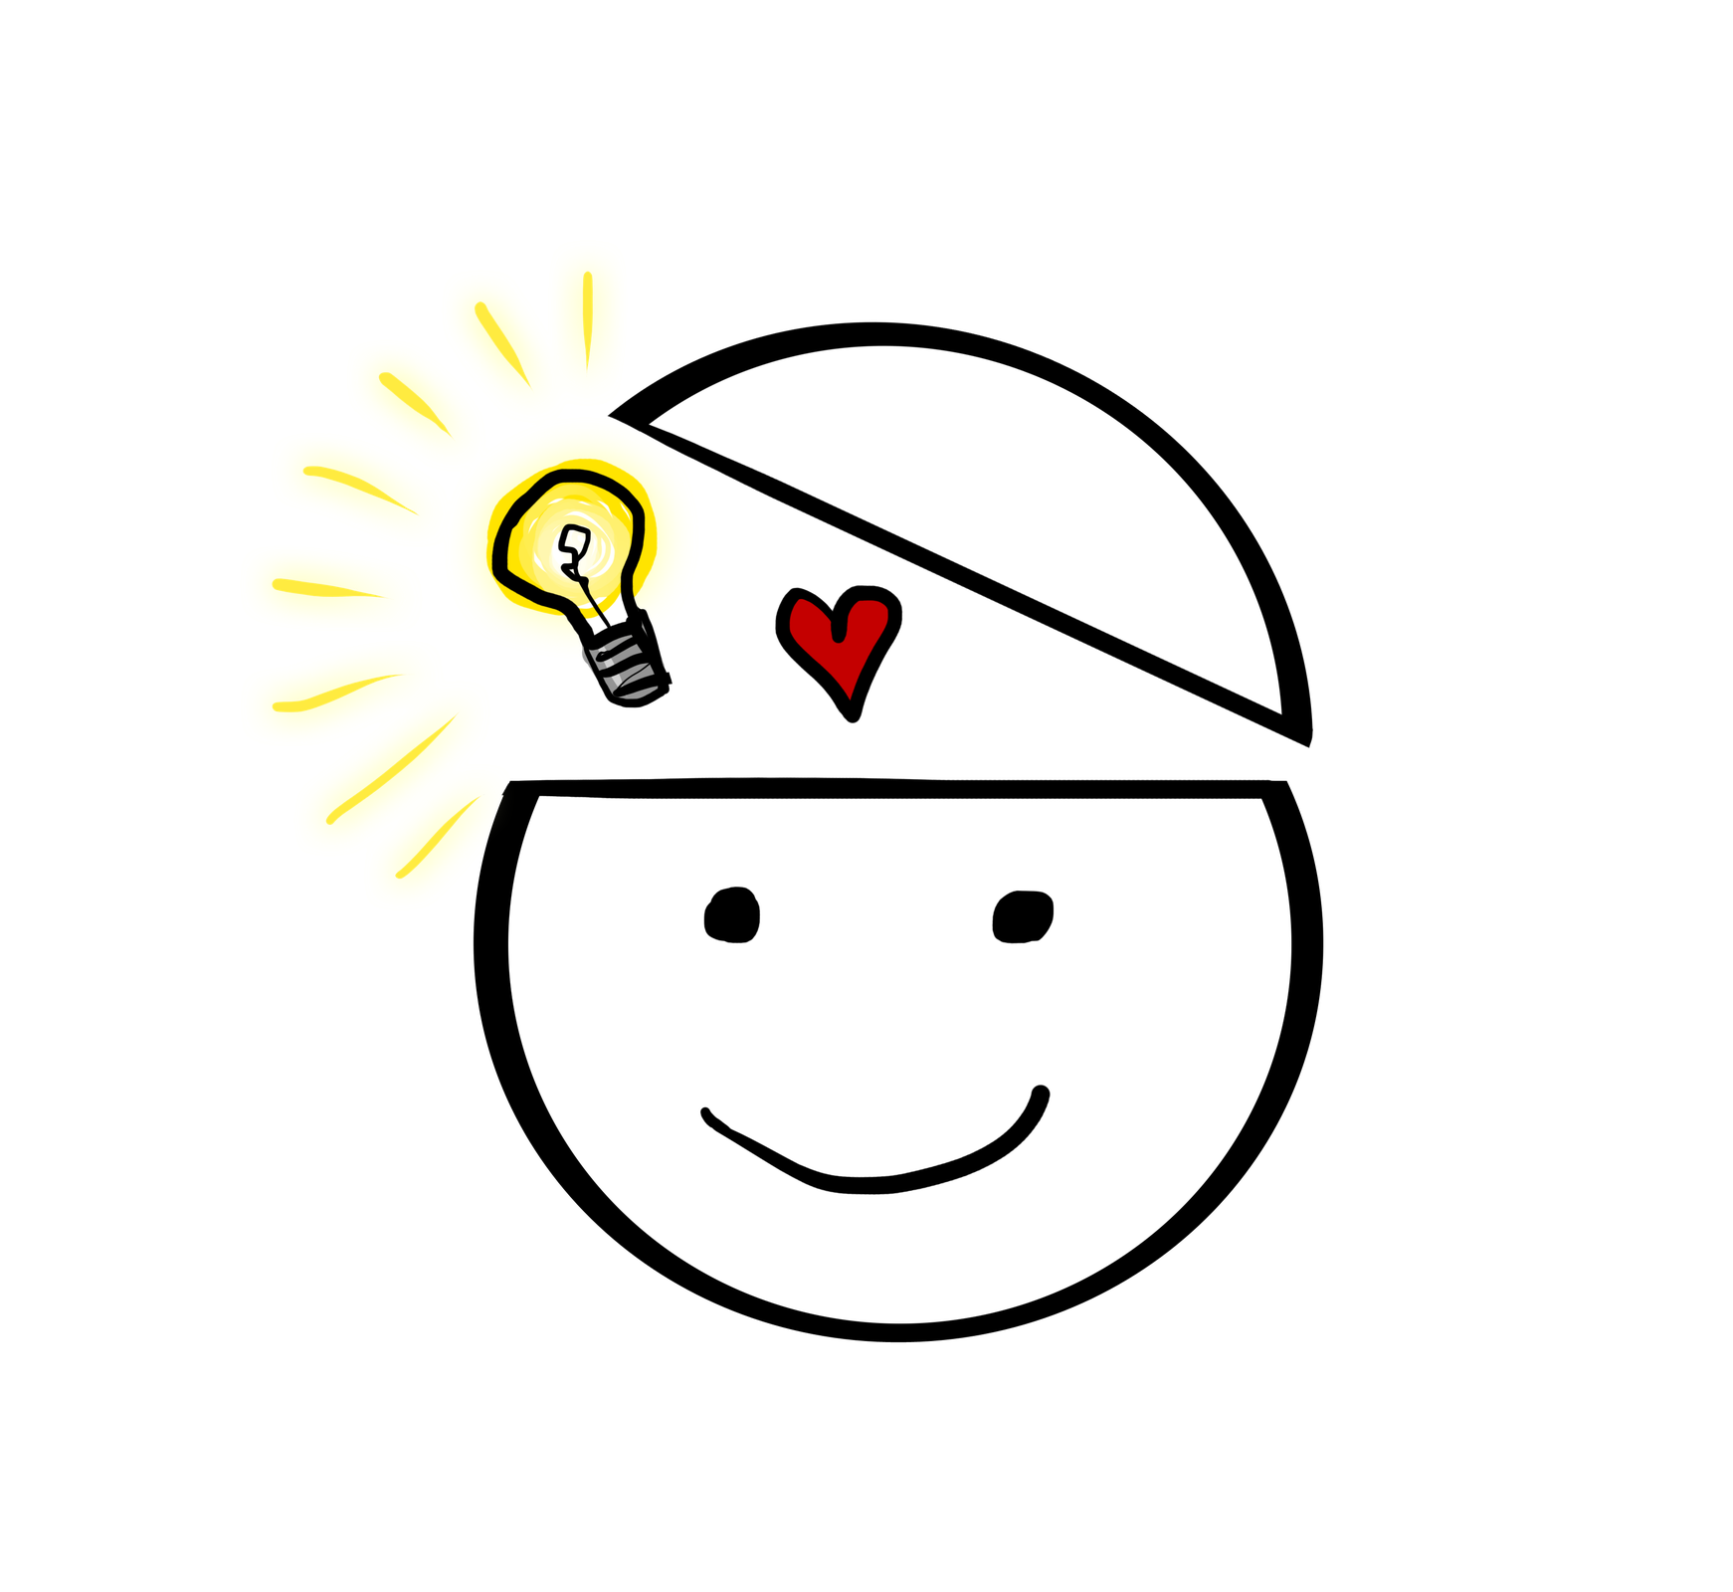
Agency and why it matters
Agency is defined as the capacity of individuals to act independently and make their own free choices.
In science education, it is an individuals’ ability to take action on their learning—or if looking at critical science agency, the ability to take action on utilizing science toward issues that matter in their lives.
Critical science agency takes an explicit political stance, linking agency to broader notions of justice and it involves using science knowledge and practices with other forms of expertise to address issues of injustice (Schenkel, Calabrese Barton, Tan, Nazar & Flores, 2019).
Notes:
The reality is that science and mathematics has created large debts in the teaching and learning of its students. What do I mean by this– Ladson-Billings in her 2006 American Educational Research Association Address reminds us of the historical, economic, sociopolitical, and moral components and its debt owed to students. From the political stance, this means how political power has limited some groups in participation vs. others. By sociopolitical, its related to power. Who has power and towards what ends. By economic, it’s who owns or has access to property and the capitalist economy in this great country. Ultimately, the moral component is what do we do to make it right for our most vulnerable students.
Science and mathematics, and coming from a science education perspective, encompasses all of these aspects. Science controls a lot of the history of this country. Beginning with racism having a scientific justification through the eugenics movement. Then thinking about the sociopolitical power that science has in schools and in research institutions by focusing on its objectivity. We then move into its economic power by the millions upon millions of dollars invested into the scientific breakthroughs, educational research through the National Science Foundation and ending with its moral aspects in questions of do vaccines cause autism to is genetic engineering moral?
Ultimately, these questions are reproduced in our classrooms. The way we teach science and the way we learn science, when not taking this “who we are stance” can create great divides that become debts. In our country, there is a great debt owed to our students in STEM education.
With increasing diversity in our K-12 schools, but with a high percentage of white middle class female teachers whose cultural, linguistic and racial perspectives are legitimized in science classrooms across the country, what does it mean to really teach beginning with who we are?

Slide 5
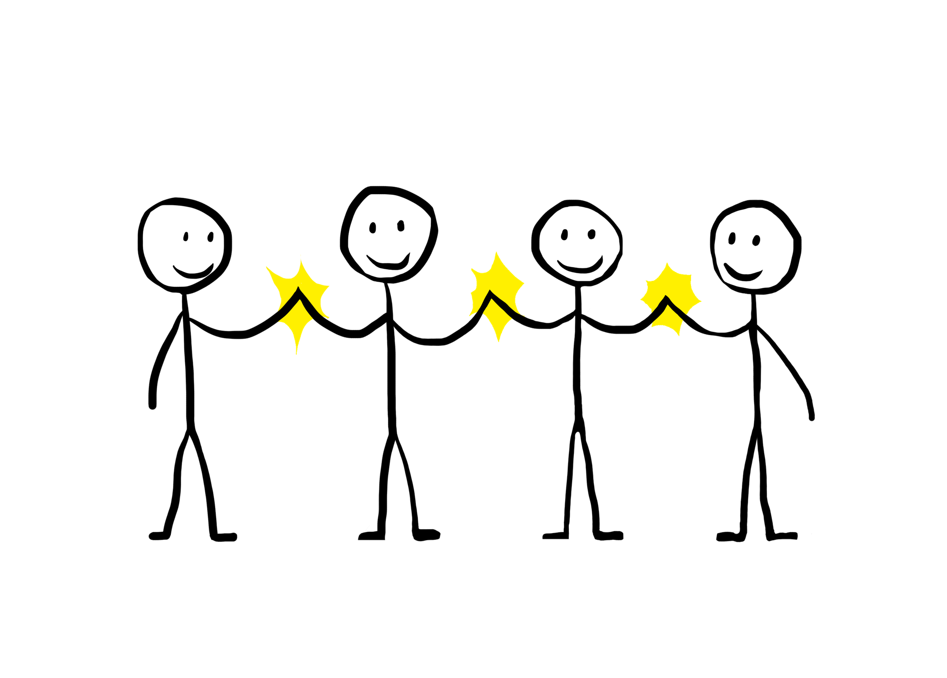
Youth, CSA and STEM
The critical nature of my work is around learning to teach from youth perspectives/knowledge from their science experiences—but important here is that teachers focus on identity (who they are) and agency (why they take action) with an eye towards politicizing and reframing injustices in their lives.
Take the case of one youth who took action to combat bullying in his community
How can we create an environment where youth can be recognized and positioned for their community experiences?
How can we support youth in taking action on this learning?
What can we do in teacher preparation to make this happen?
Notes:
I want to begin with my work and why its so important. I came into science education as a student who believed that I had a great science education. I grew up in Passaic, New Jersey. It’s a city not too far from NYC and at the time it was one of the 5 worst school districts in the State of New Jersey. Our community was becoming increasing diverse, yet teachers were pressed to teach students whose first language was not English, difficulty communicating with parents (like mine) and whose students needed the additional support to be successful.
My science experiences were mostly discourse driven. A lot of us as teachers and I will say I myself have fallen into this: develop an easier approach to science through initiate, respond and evaluate type of discourses.
Show of hands: How many of us use worksheets in at least 3-4 days of week of our science or mathematics classes? How many of us do “projects’ or inquiry-based work in our science classes?
A lot of times, people in science will say “make it more relevant” “use more experiments’ “use inquiry” but in reality—none of this really matters. You cannot have good science teaching without deep engagement in core ideas, and you cannot have good science without good engagement in practices, and you can’t surely have good science teaching if you can’t articulate the connections between the subject areas.
I will explain one example of this: Think about energy for example. Some of us know that energy is the capacity or power to do work, such as the capacity to move an object (of a given mass) by the application of force. But energy is used in physical science, life science, earth and space science in different ways but get at the same concept. Energy is what helps us carry out our everyday lives. That same energy—which helps you move, can also be transferred to a hand crank for example (use hand crank—to turn on LED) to power up this LED light. We never think about our biological energy powering up a light bulb—and talking about sustainability? But imagine having an entire lesson revolve around that one experience and being able to talk about it from how you lived turning on that LED light.
Why did I begin with that—because youth make these connections all the time. Their experiences, perspectives and knowledge become critical junctures in science teaching and learning. They are experts in how they are able to experience these connections. Take for example a student who created a ”solar-panel fan hat” to help her grandmother who attends an un-air-conditioned church in the summer time. Why is this important to her? She created a hat to help her grandmother attend church service without getting sweaty. She used her grandmothers fancy hat as a starting point and used a green energy source such as a solar panel to turn on the fan in the hat that would then blow air into the grandmother’s face. Imagine this same student making connections to cancer for example? If people used the fan hat to go outside in the beaming sun, they are both lessening their exposure to getting heat stroke and at the same time reducing their exposure to harmful sunlight rays. These are all different content area connections to science, but they are ultimately connected to their lives and the meaningfulness of these connections to practice.
My question is how do we make these a regular part of our teaching? How can students legitimize this in their learning?

Slide 6
The Next Generation Science Standards
Notes:
Crosscutting Concepts help students explore connections across the four domains of science. These include Physical Science, Life Science, Earth and Space Science, and Engineering Design. When these concepts are made clear to students, they can help students develop a coherent and scientifically-based view of the world around them.
Science and Engineering Practices describe what scientists do to investigate the natural world and what engineers do to design and build systems. The practices better explain and extend what is meant by “inquiry” in science and the range of cognitive, social, and physical practices that it requires. Students engage in practices to build, deepen, and apply their knowledge of core ideas and crosscutting concepts.
Disciplinary Core Ideas (DCIs) are the key ideas in science that have broad importance within or across multiple science or engineering disciplines. These core ideas build on each other as students progress through grade level. We commonly look at their progressions in education research to understand how knowledge of these ideas build over time.

Slide 7

Thinking about our own CSA in STEM
Today, I want us to unpack our STEM agencies
We will use break out rooms to discuss how we have taken action in our STEM education.
Starting with Christopher’s case, how have you done this and why have you taken action.
If you have not take action, then when could you have taken that action?
Notes:
In this part of the presentation, remind participants what they have learned. We learned that students come into STEM with their own practices, and we called it repertoires of practice. That we must avoid thinking about STEM learning involving students being grouped in categories based on their ethnic or cultural identity. This narrative is what has contributed to creating a culture of power in science. Those that don’t look like scientists and engineers can’t do STEM.
For this activity today, we will look at our identities as we enter STEM. Who are we, and how can we begin to think about perspectives and experiences in ways that are connected to who we are.
Each section (depending on the room—this will change) will have a large post-it note paper. Each section will have one for PSTs, teachers and students—the three stakeholders present with us in this professional development. In your tables, you should also have post-it notes that will help you outline some of those key pieces of identity.
On the post it note, write down some key pieces of identity that is related to who you are. I will write that I am a wife, daughter, niece, science educator, professor, friend, Arab-Colombian American, etc…
Once you finish writing them down, then put them in the corresponding notepad section you are in. If you are on the right of the room and you are a PST then put it in the PST poster so that others can read about the identities that are there.
We will give folx 20 minutes to complete this activity

Slide 8
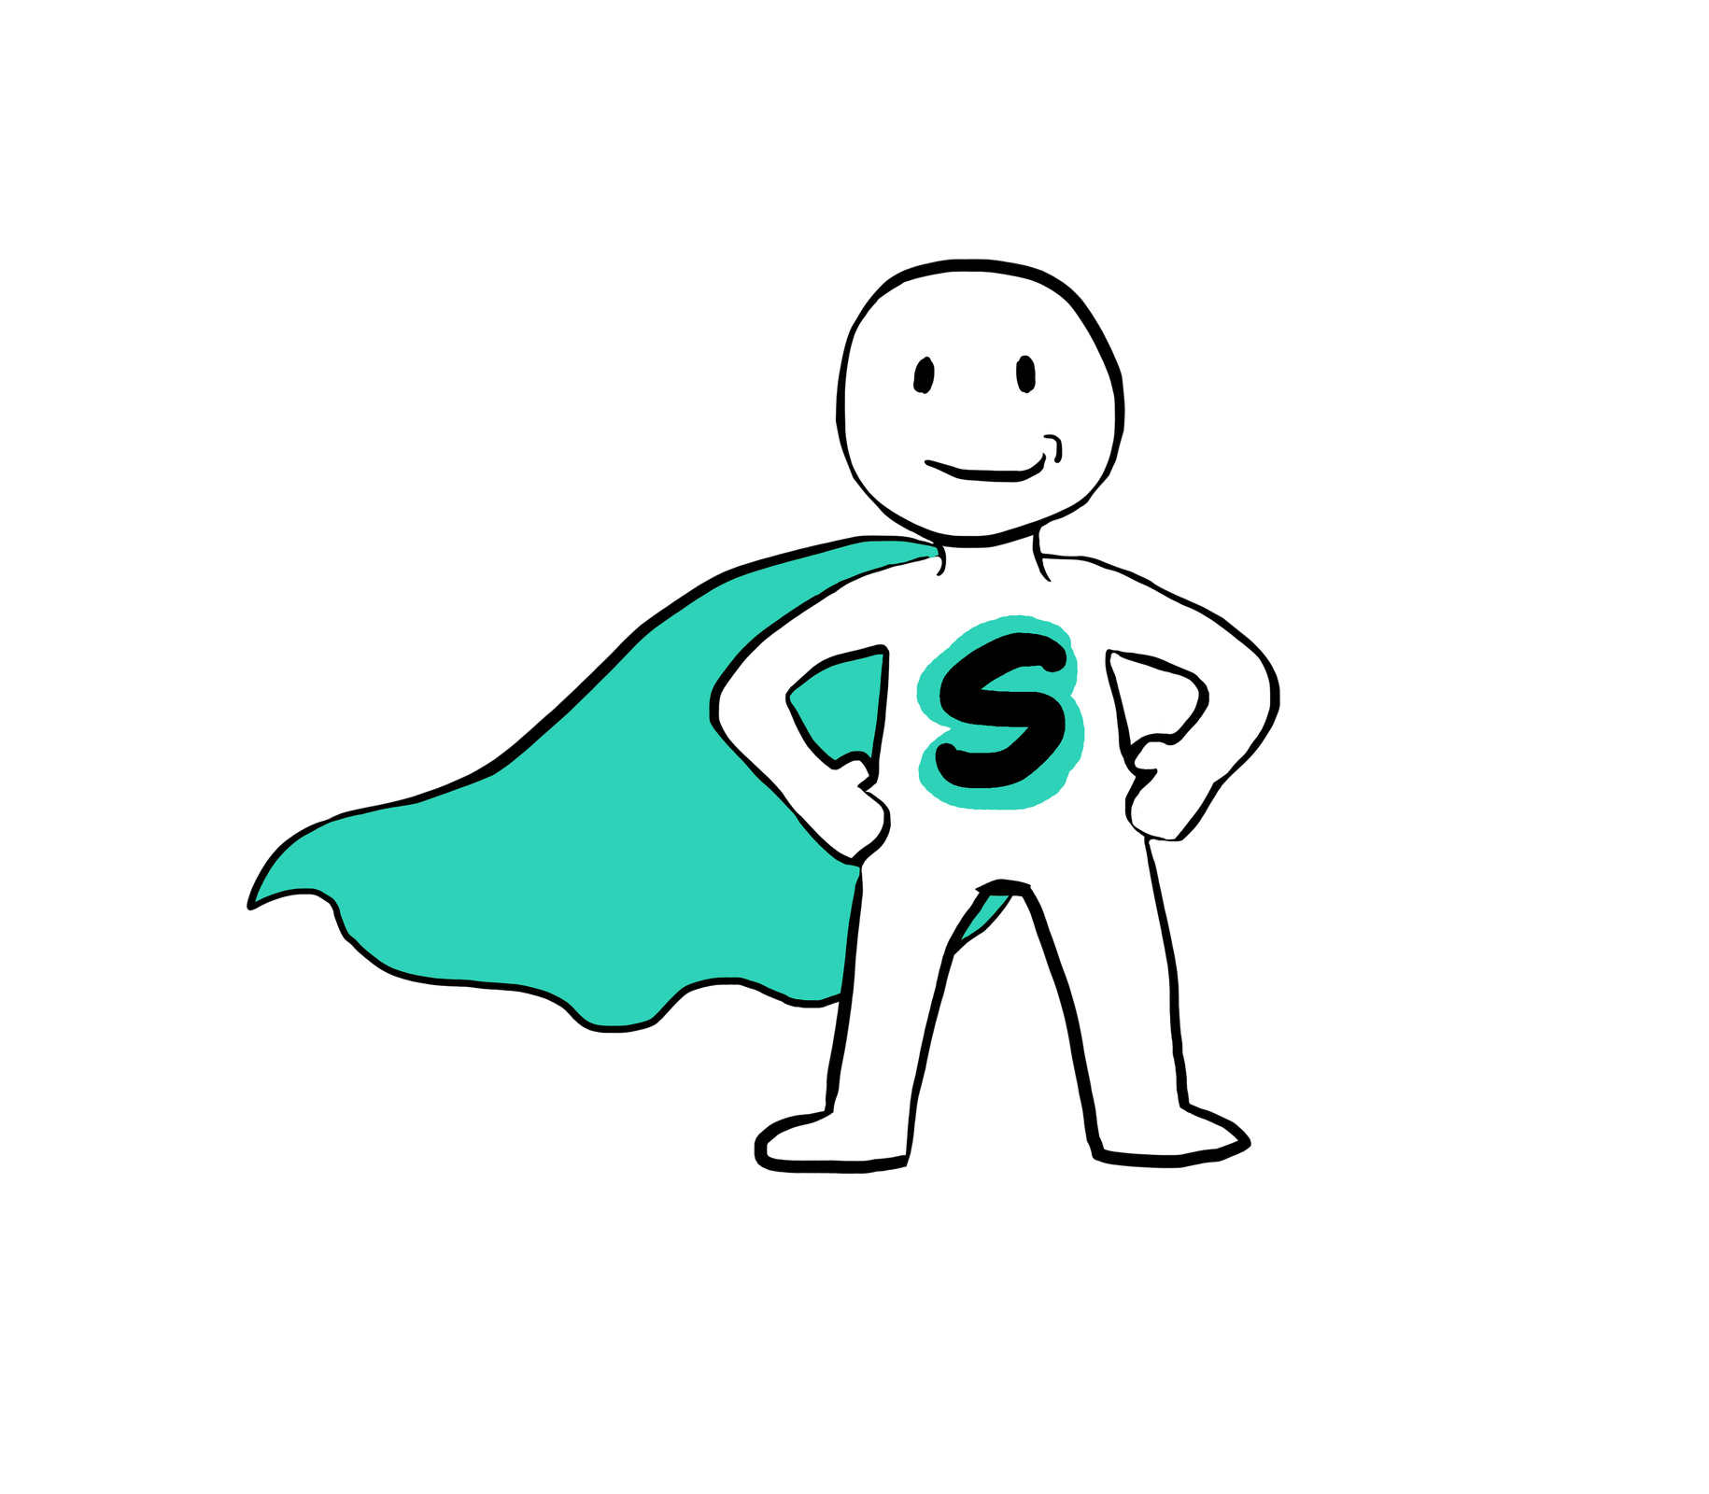
Agency – How our work in teaching may redefine action taking for our students.
Believe it or not, there are students who are their own superheroes/heroines.
They believe that they knew what’s best for their community and will take action on that knowledge as they engage with science.
In our break out rooms, let’s discuss how you will take action in your teaching to support students taken action on their learning.
Notes:
Here, we focus on the idea of agency and how the ability to take action on something is deeply connected to who and what we are. Youth provide us with important connections to everyday life experiences which can be part of a fulfilling STEM trajectory—if teachers learn to uphold these views in their teaching. By breaking apart these binaries which often times make us fall back on the goal which is to support students in their whole lives, we will lose important opportunities for youth to express exactly who and what they are and believe they could become.
Discussion on focal student will be here.
Now, for the rest of the presentation, we will be working in our groups (one PST, one teacher and one student) to develop a thematic understanding of what would be a good STEM topic that could uphold a view, or a perspective or an identity through the lens of youth in our classrooms. In the 8X11 sheets provided, please develop your work.
The sheets will be explained

Slide 9
Summary: Our goal is to focus on the youth and open borders to the culture of power in science
NGSS 3D
Identity
Agency
Is a blueprint to help us understand how to teach science from the perspective of scientists and science discipline
Is who, what and at times where we are and what we are connected to in different moments in time. Identities can and will change.
Is taking action on who we are and where we want to be. In STEM we can meaningfully connect science and identity to support students in agentic ways
Notes:
To summarize the presentation, we focused on how practices exist in STEM, and that they are oftentimes dictated by what scientists do and understand. How they identify and do the work of science.
Today, we focused on our identities to understand how these then can contribute to taking action in science.

Slide 10
Thank you very much
Any questions?
crestre2@calstatela.edu

