Slide 1

Mindfulness
Practices
Presented by Melanie Levy of Long Beach City College
Notes:
Photo by Andrea Piacquadio from Pexels

Slide 2

Agenda
Grounding
The Brain
Breathing
The Nervous System
Sensory Check-In
The Body
Wrap Up + Evaluation
Notes:
Photo by Retha Ferguson from Pexels

Slide 3

Acknowledgements
Tongva People
Hindu Philosophy
Buddhist Philosophy
Social Determinants of Health
Notes:
Photo by Gratisography from Pexels
https://www.uclahealth.org/marc/research

Slide 4

Grounding
When & Why
Notes:
Photo by Pixabay from Pexels

Slide 5
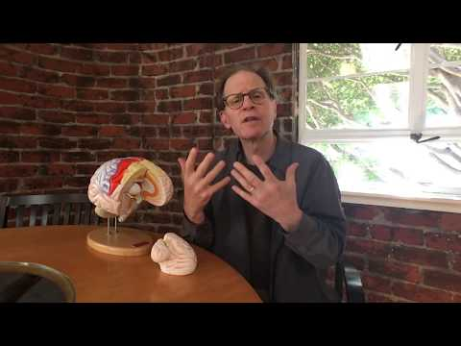
Dr. Siegel’s Hand Brain
As we watch this clip, think about how this relates to your experiences in the classroom.
What do you think is most meaningful for a teacher?

Slide 6

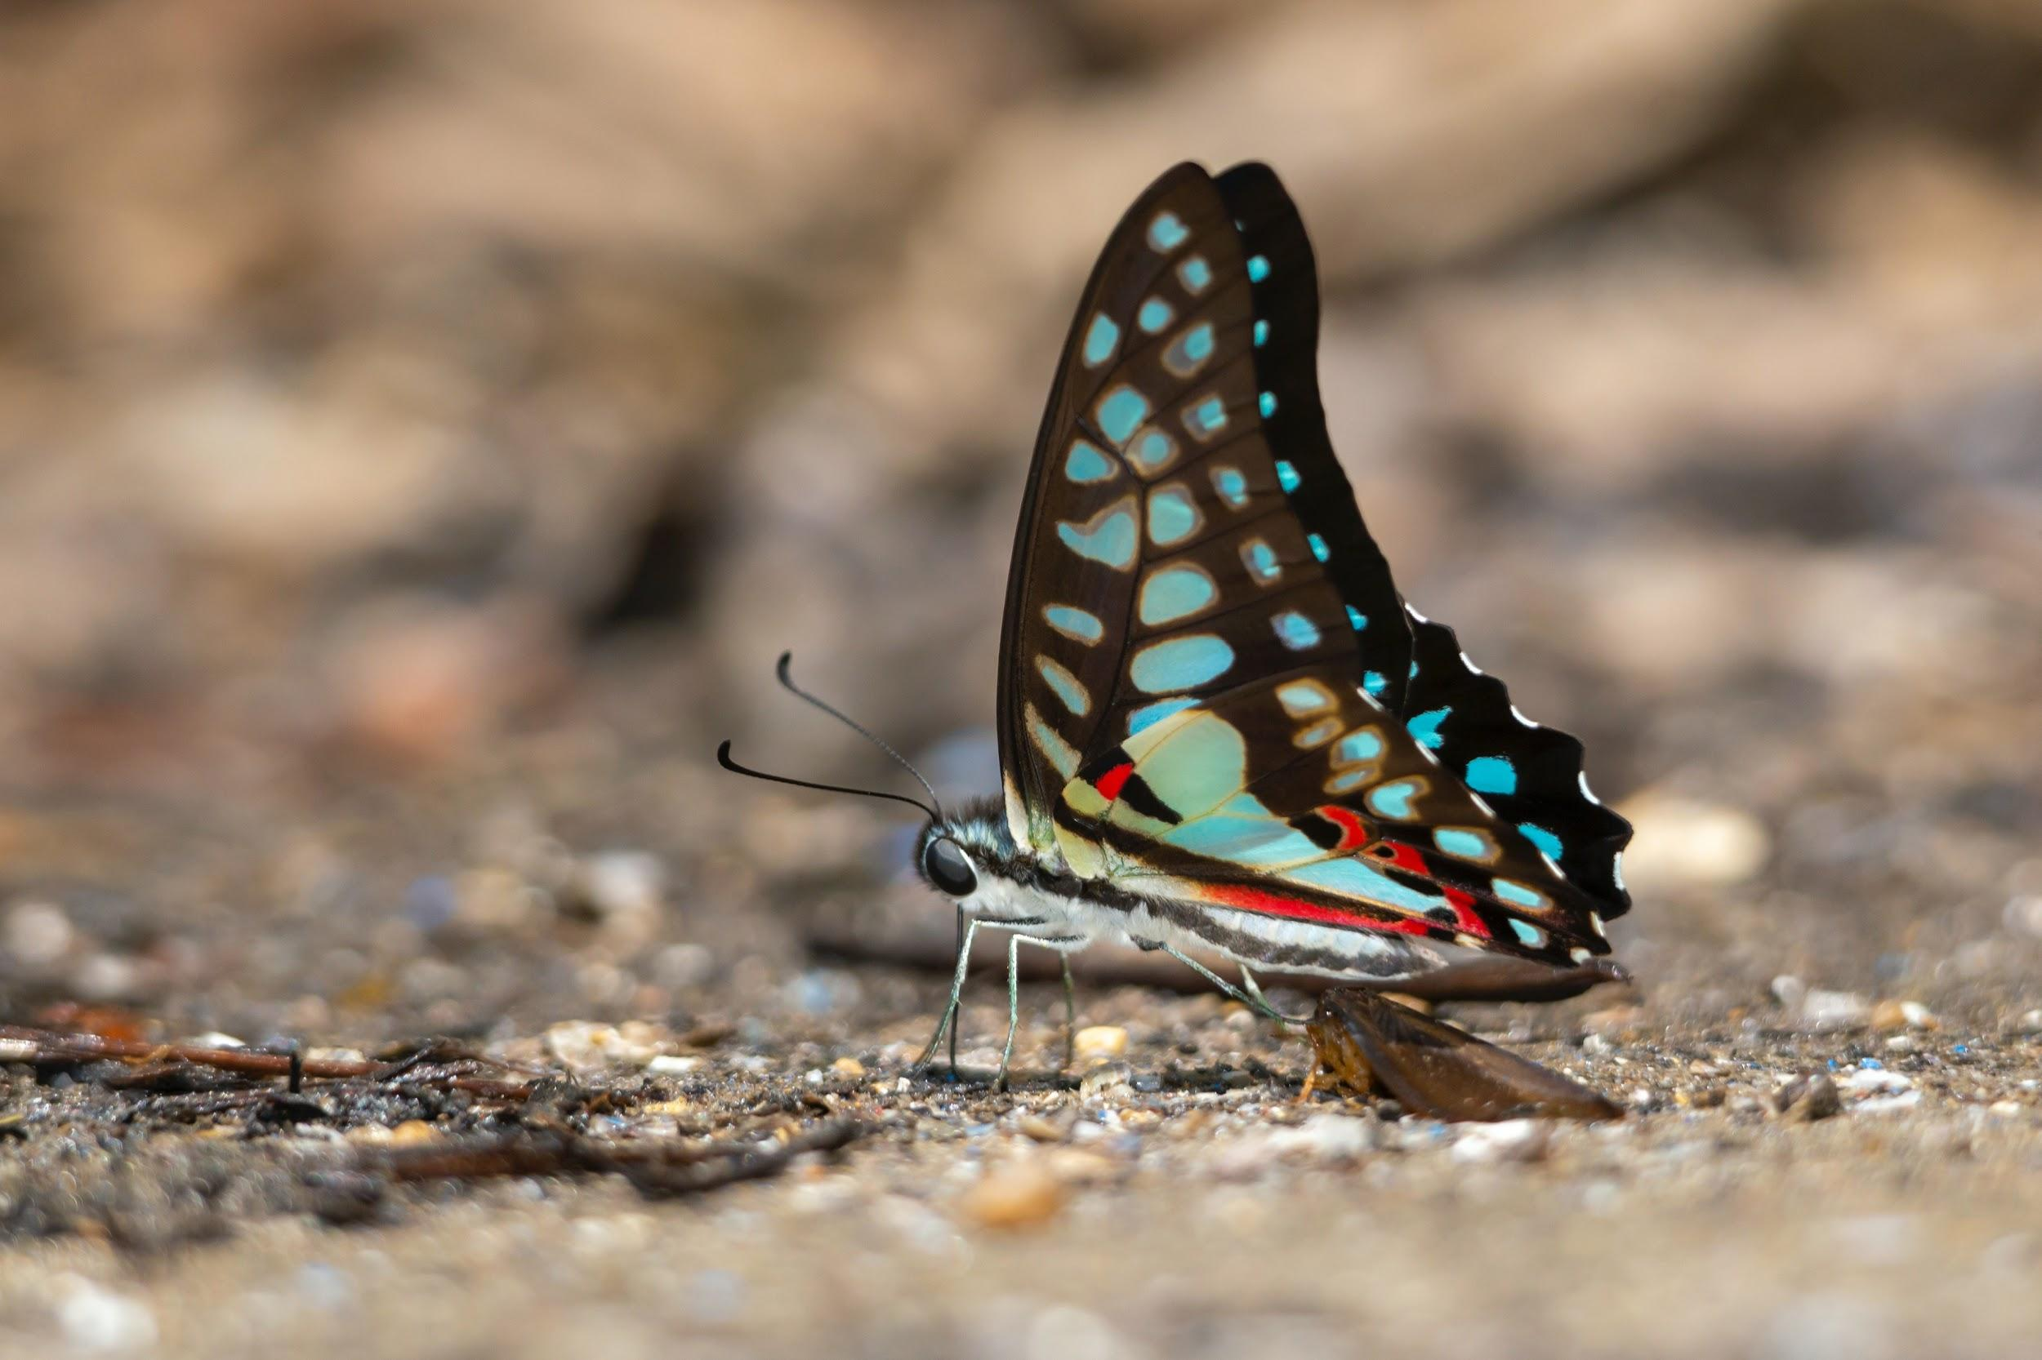

Breathing
Alligator
Butterfly
Hot Cocoa
Notes:
Photo by Erik Karits from Pexels

Slide 7

Breathing & The Nervous System
“The sympathetic nervous system functions like a gas pedal in a car. It triggers the fight-or-flight response, providing the body with a burst of energy so that it can respond to perceived dangers. The parasympathetic nervous system acts like a brake. It promotes the "rest and digest" response that calms the body down after the danger has passed.”
Understanding the Stress Response
Notes:
https://www.sciencedirect.com/science/article/pii/B9780128036334000016
https://www.healthline.com/health/breathing-exercises-for-anxiety#yoga-breaths

Slide 8

5-4-3-2-1
“In the moment” mindfulness
5 things you can see
4 things you can hear
3 things you can touch
2 things you can smell
1 thing you can taste
Notes:
https://www.vice.com/en_us/article/9kzw78/a-mindfulness-trick-called-5-4-3-2-1-can-help-ease-anxiety-immediately
Photo by Carlo Martin Alcordo from Pexels

Slide 9

Ellen Hendriksen
Social Anxiety Sidebar!
Notes:
Photo by Philip Boakye from Pexels

Slide 10

The Body
Food
Movement
Sleep
Security
Notes:
Photo by Retha Ferguson from Pexels

Slide 11

Thank you!
Wrap-Up
Evaluation
Goodbyes
Questions & Comments
Resources
Survey

