Slide 1


Undergrads Applying
To The Teaching Credential

Slide 2
Agenda
What degree to you need to become a teacher?
How does the undergraduate program look with the teaching credential?
Are there any requirements to apply?
Who is CTC?
Exam Requirements

Slide 3

ANYONE CAN EARN A TEACHING CREDENTIAL
What degree to you need to become a teacher?
Degree Options?
Anyone with a degree can earn a teaching credential, if they meet the demands of the teaching credential agency
HOWEVER! If you choose a teacher prep program, you might qualify to waive one of the exam requirements

Slide 4
What degree to you need to become a teacher?
B.A. Urban Learning Multiple Subject/ Special ED
B.A. Chicano Studies Multiple Subject/ Special ED
B.A. Natural Science Single Subject Biology
Combining a Bachelor’s Degree with a Teaching Credential
B.A. Mathematics Single Subject Mathematics
B.A. Child Development Multiple Subject/ Special ED
B.A. Liberal Studies Multiple Subject/ Special ED

Slide 5
BA in Urban Learning
What degree to you need to become a teacher?
Four Options:
What’s special about this major?
Teacher Prep in Elementary Education
Teacher Prep in Education Specialist
Teacher Prep in Dual Credential
Teaching & Learning (degree-only)
Community-focused— family and community-centered and it emphasizes how education impacts urban communities

Slide 6
BA in Liberal Studies
What degree to you need to become a teacher?
Three Options:
What’s special about this major?
General Option
Teacher Prep in Elementary
Teacher Prep in Special Education
Interdisciplinary– it takes from different disciplines to prepare you in a broad education

Slide 7
BA in Child Development
What degree to you need to become a teacher?
Two Options
What’s special about this program?
General Option
Teacher Prep Option (not always available for transfers)
Child-centered– The major focuses on the development of the child

Slide 8
BA in Chicanx Studies
What degree to you need to become a teacher?
Three Options
What’s special about this program?
General Option– degree-only
Elementary Subject Matter Teacher Preparation: Traditional Option
Elementary Subject Matter Teacher Preparation: Integrated Option
Interdisciplinary program that pulls from literature, social science, education, politics, pop culture, social media, immigration, pulic health, social policy, and social justice and the impact on the chicana/o and Latina/o community.

Slide 9
What degree to you need to become a teacher?
Beyond Multiple-Subject preliminary credentials (to teach elementary, K-8), the CCOE offers Single-Subject preliminary credential programs in the following subject area:
Art | English | Industrial & Technology Education
Spanish | Mandarin (Chinese) | Korean
French | Foundational-Level Mathematics | Japanese
Mathematics | Music | Physical Education
Science: Biological Sciences | Science: Chemistry | Science: Geosciences
Science: Physics | Foundational-Level Science | Social Science
AVAILABLE PATHWAYS
Los Angeles Urban Teacher Residency Program (STEM Single-Subject)
Integrated – Traditional – Intern

Slide 10
How does the undergraduate program look with the teaching credential?
TRANSFER STUDENTS- ITEP OPTION
Transfer
Year 1
DEGREE COURSEWORK/ Upper GE’s
Transfer
Year 2
DEGREE COURSEWORK/
Cred courses
DEGREE COURSEWORK/ Cred pre-req’s
Transfer
Year 3
Degree coursework/ Credential classes
Student teaching/ graduation
Degree courses/ cred courses
This is a general idea!
Everyone’s degree progression is unique

Slide 11
How does the undergraduate program look with the teaching credential?
TRANSFER STUDENTS- NON-ITEP OPTION
Transfer
Year 1
DEGREE COURSEWORK/ Upper GE’s
Transfer
Year 2
DEGREE COURSEWORK/
electives
DEGREE COURSEWORK/ Upper GE’s/
electives
DEGREE CORUSEWORK/ graduation
Year 3
POST BACCALAUREATE
Pre-req
Credential classes
Cred courses
Year 4
POST BACCALAUREATE
Cred courses
Student teaching
This is a general idea!
Everyone’s degree progression is unique

Slide 12
Application Requirements
CCOE Application
Undergraduate Students
Minimum 60 units
Negative TB results
Two letters of recommendation
CBEST (attempt/registration)
Unofficial transcripts
Certificate Of Clearance! NOTHING NEEDS TO BE UPLOADED for this
Application fee
Philosophy statement
2.67 Overall GPA
APPLICATION LINK:
https://calstatelacbe.radiusbycampusmgmt.com/ssc/aform/KKx675Gc003m0x67125s.ssc

Slide 13
What Is Happening with COVID-19
CBEST
  Attempt required
  At least submit registration ticket
  Passing score required by student teaching
CSET
  As an ITEP student, if you qualify for the waiver, you do not need to take it
Certificate of Clearance
  Still required
  Livescan and registration with the commission (refer to video in slide 6 for process)
  *SUBJECT TO CANGE
OTHER WAYS TO MEET BASIC SKILLS:
CTC has a list of approved exams, such as SAT/ACT
Click here to read other options

Slide 14
Who Grants The Teaching Credential?
Ctc.ca.gov
The Commission on Teacher Credentialing is the licensing agency who issues all education credentials and clearances in California. Once you are eligible, the Charter College will recommend you for your credential but CTC will issue the document.
Once a permit, clearance, or credential is issued it is public information that anyone can view.
1

Slide 15
Credentialing Requirements
Complete a baccalaureate or higher degree from a regionally-accredited college or university
Satisfy the basic skills requirement (CBEST)
Complete subject-matter program
Complete a Commission-approved credential program in the area that you will be teaching
Complete U.S. Constitution (class/exam)
CPR
RICA (for multiple subject or SpEd)

Slide 16
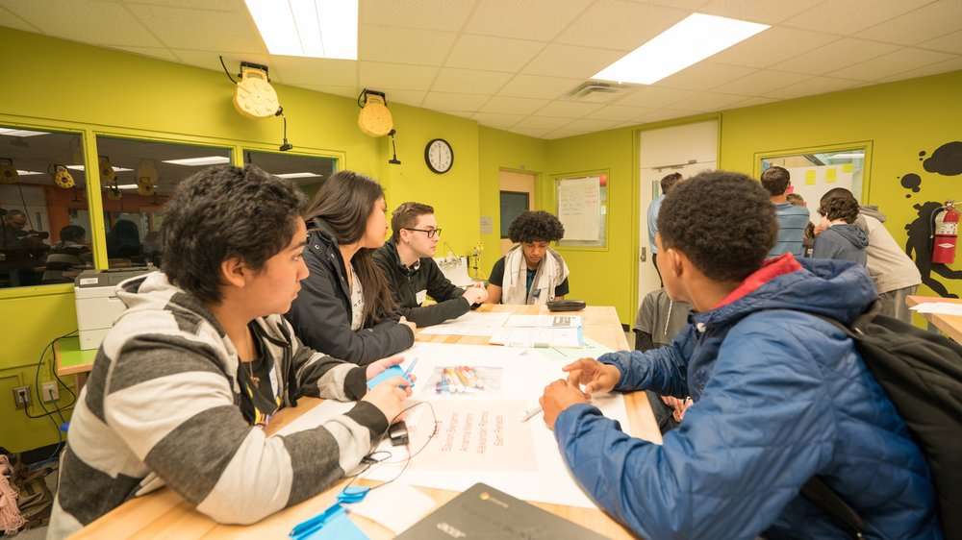
Integrated Student Expectations
Your Responsible for the following:
Follow what your advisor says for your major!
Take EDCI 4000 upon admission!
If you have not taken other pre-req courses, try to take them the semester for which you’re admitted.
Student teaching (in general)
If you qualify for the Subject Matter waiver, you will contact your major advisor to request that they send the blue card to the CCOE
Others: complete it after graduation
ITEP you can complete it as an undergrad

Slide 17
Q&A
Contact me:
Ana Zambrano
  azambra7@calstatela.edu
  Cell: 323-212-5362
  Zoom ID: 719 793 2487
    https://calstatela.zoom.us/j/7197932487
  OR SCHEDULE AN APPOINTMENT ☺
Any questions about credentialing or what the best option for you, please feel free to contact me! ☺

